Slide 1
3D synthetic microstructure generation involving grain size, shape and orientation representation
Sheila Lizardi Schad
Aalto University
Mondragon university
Professor
Juhne Lian
08.07.2021

Slide 2
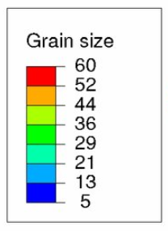
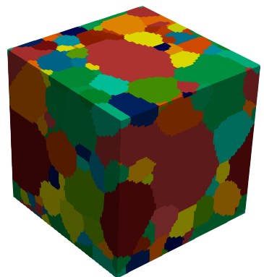
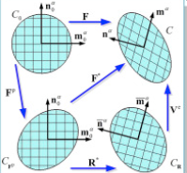
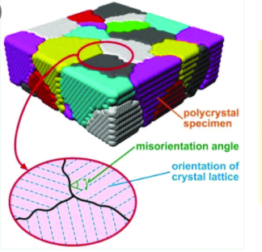
Index
Grain size
RVE generation
Workflow
Grain shape control
Evaluation
Further developments
Post-process
Grain shape aspect ratio evaluation
Grain axis orientation control
Final RVE
RVE with other filters
Variant grain shape aspect ratio
Variant grain axis orientation
Conclusions and outlook
Grain shape
Grain orientation
Misorientation angle
Orientation of crystal lattice

Slide 3
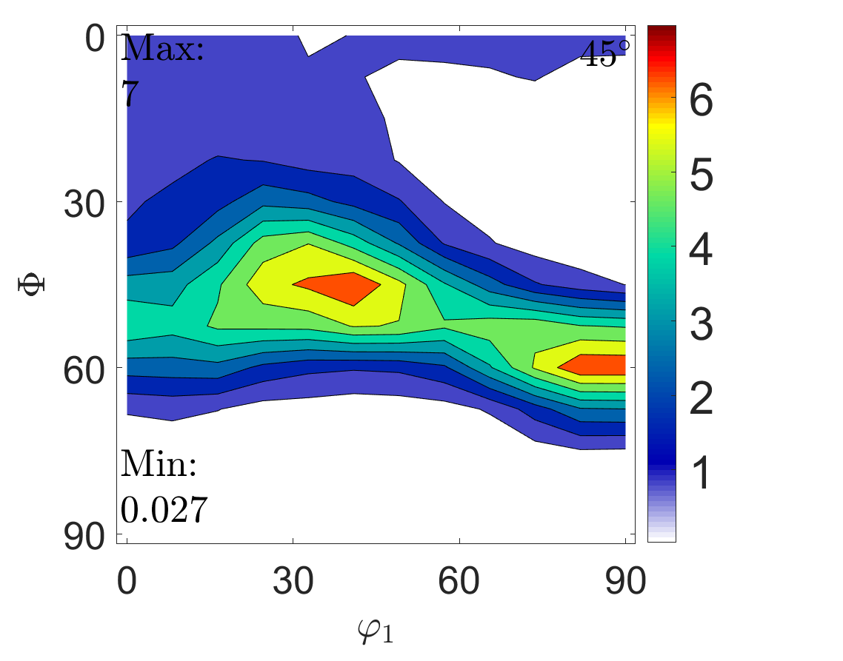
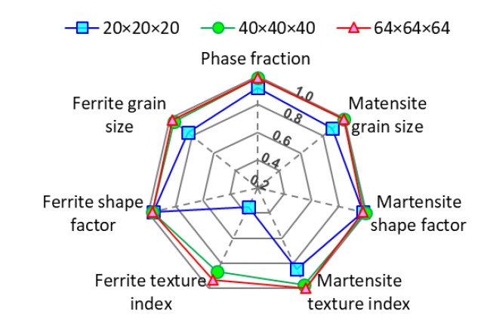


RVE generation – Workflow
Microstructure characterization
Grain size / shape / orientation distribution figures
Representativeness of RVE → MRAC / MRAD
$$∆X=\frac{\left|X_{RVE}−X_{ref}\right|}{X_{ref}}×100\%$$
Δ=mean$({∣∆}_{d}∣,{∣∆}_{asp}∣,{∣∆}_{ODF}∣,{∣∆}_{t}∣)$
$$X_{r}={X_{ref}}/{X_{RVE}}$$
[1] W. Liu, J. Lian, N. Aravas, and S. Münstermann, “A strategy for synthetic microstructure generation and crystal plasticity parameter calibration of fine-grain-structured dual-phase steel,” Int. J. Plast., vol. 126, no. October 2019, p. 102614, 2020, doi: 10.1016/j.ijplas.2019.10.002.

Slide 4

RVE generation – Grain shape control
Three different approaches
Equiaxed
Average method → Mean values
Grain shape distribution → Fitting parameters of beta distribution →
Optimal numerical parameter → Mesh size
RVE uncertainty →10 parallel RVE generations
$$f\left(x;α,β\right)=\frac{1}{B\left(α,β\right)}x^{α−1}{\left(1−x\right)}^{β−1}$$
 | Shape distribution a | Shape distribution b (RD-TD) | Shape distribution c (RD-ND) | Alpha parameter | Beta parameter
Equiaxed | 1 | 1 | 1 | - | -
Average method | 1 | 0.74 | 0.72 | - | -
Grain shape distribution | - | - | - | 4.73 | 1.62

Slide 5
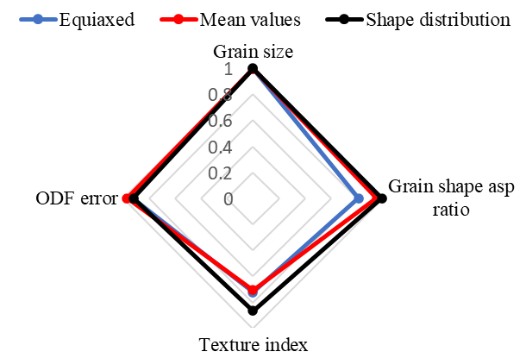
RVE generation – Grain shape control
Taking any grain shape control method it can be seen how the mesh size does not affect much on results
The best approach is the beta distribution method → Gets the closest to experimetal results
 |  | Grain size | Grain shape asp. Ratio | ODF error | Texture index | Δ, % | Grain number
Approach | Equiaxed | 0.0005 | 0.23 | 0.92 | 0.27 | 2.38 | 2705
 | Mean values | 0.0026 | 0.04 | 0.97 | 0.29 | 1.82 | 2693
 | Shape distribution | 0.0010 | 0.0103 | 0.72 | 0.15 | 1.11 | 2697
Microstructure representative assessment criterion
Best approach → Shape distribution
Grain size error → very small in all three cases
The texture index error → Best with shape distribution

Slide 6
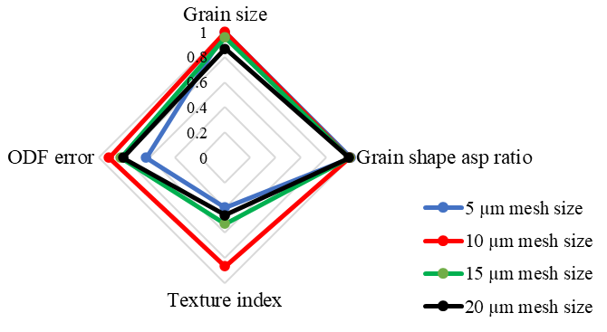
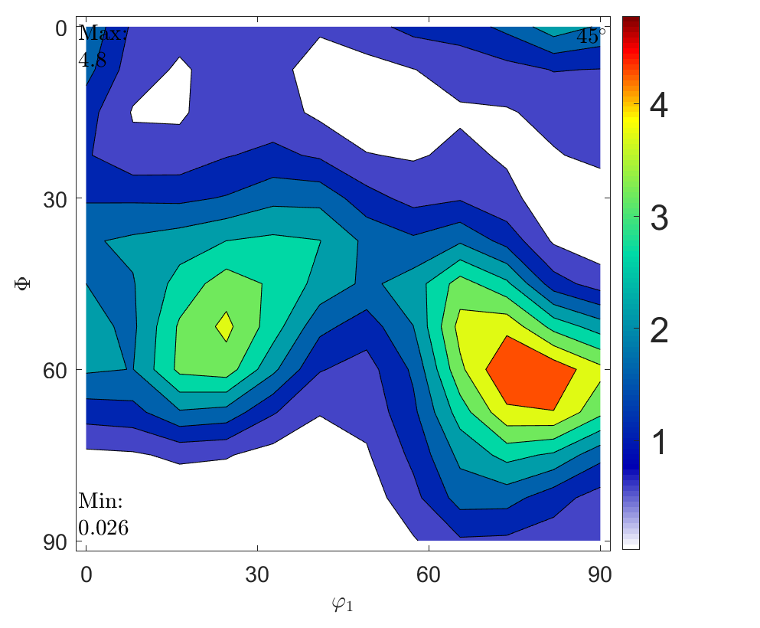
Evaluation – Mesh size
Mesh size, μm | Grain size | Grain shape asp. ratio | ODF error | Texture index | Δ, % | Grain number
5 | 0.01 | 0.0002 | 1.60 | 1.52 | 4.7 | 378
10 | 0.0010 | 0.0103 | 0.72 | 0.15 | 1.11 | 2697
15 | 0.05 | 0.0119 | 0.82 | 0.47 | 4.12 | 7832
20 | 0.15 | 0.015 | 0.80 | 0.53 | 4.33 | 15694
Comparation of exp. data and output for:
Grain size Orientation

Slide 7
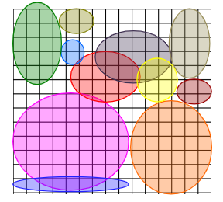
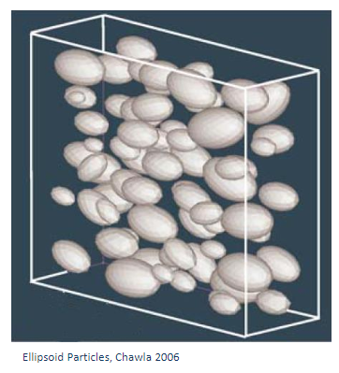
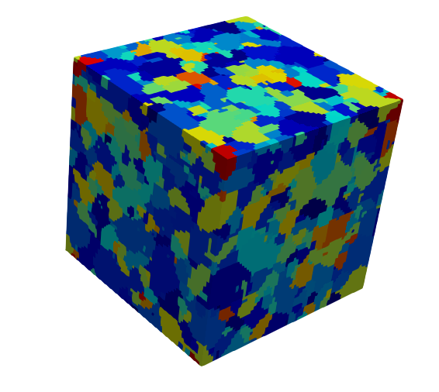
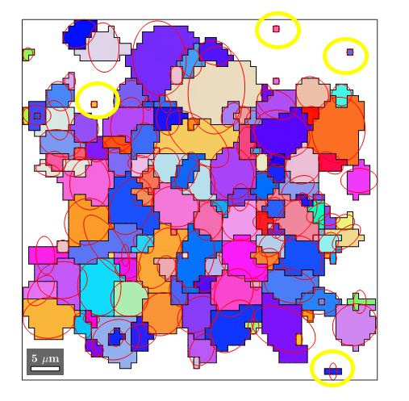
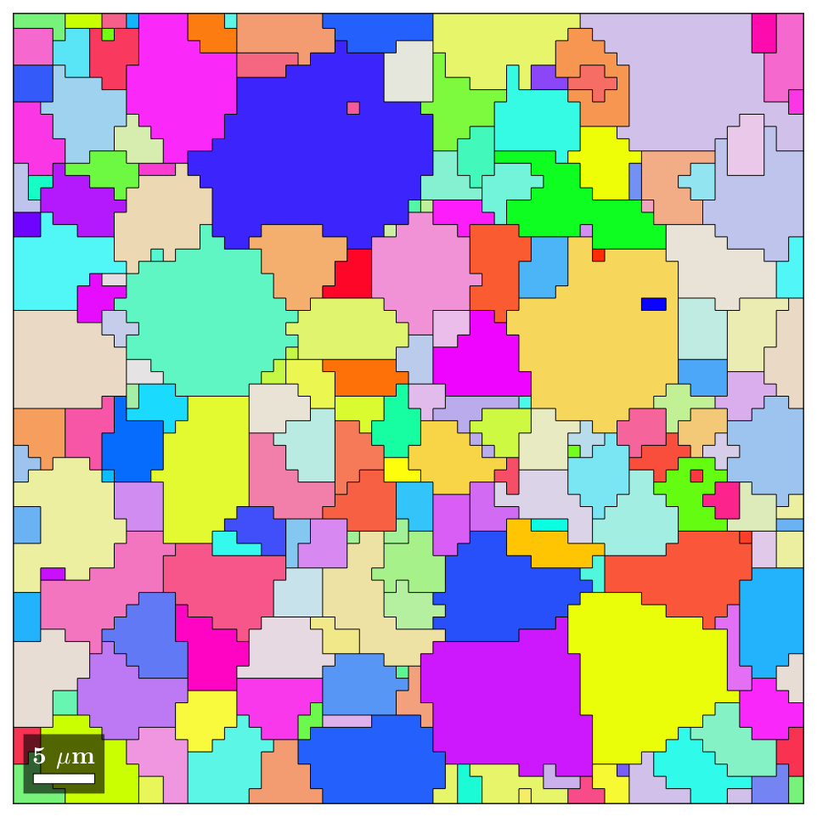
Further development – Post-process
2D
Using DREAM3D and MATLAB/MTEX
1. Procedure grain
3D
Data from generated ideal ellipsoid seeds
Data overlapping, and does not fulfill the whole 3D space
[2] Generating Synthtic Microstructures w/DREAM3D: An overview Tutorial, The Air Force research laboratory
2. Final grain morphology
Create final RVE and analyze with data from all layers
Do analysis of each 2D plane
Remove edge grains and one size pixels

Slide 8
Further development – Grain shape aspect ratio control
Big improvement in grain shape aspect ratio results

Slide 9
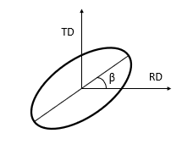
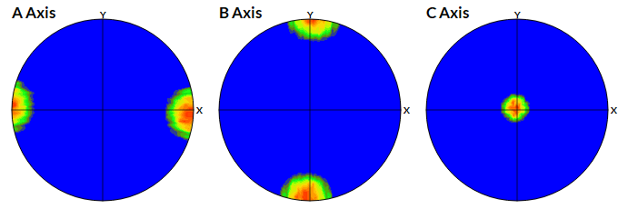
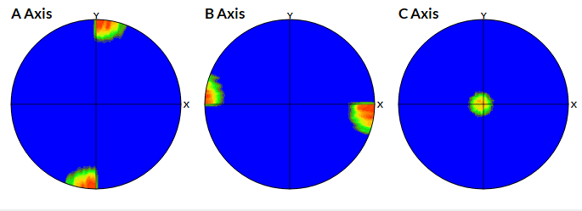
Further development – Grain axis orientation control
Grain axis orientation: orientation between the RD axis and the longest axis of the fitted ellipse.
For control in DREAM3D
Input for every 15 degrees
Depending on the density → Higher or lower input values
Strong orientation → Small standard deviation values for input
The analysis of the orientation is done with MATLAB/MTEX
0º
90º

Slide 10
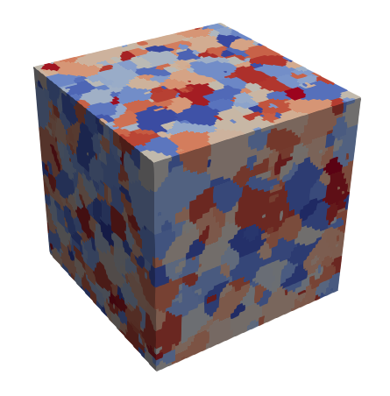
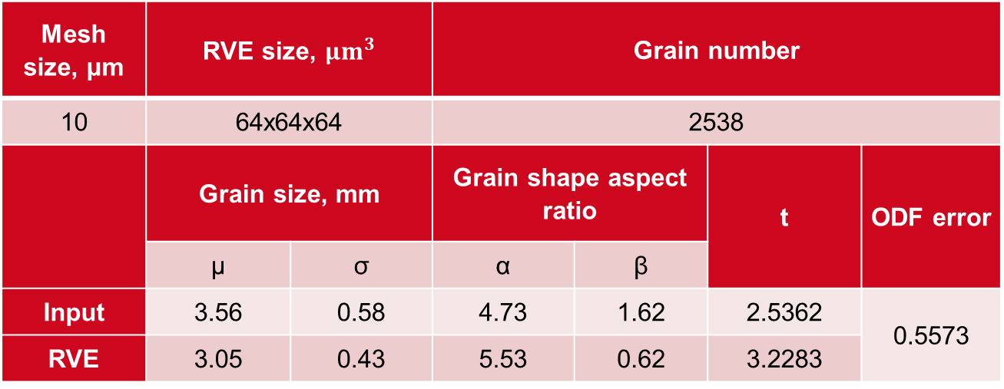
Final RVE
Mesh size, μm | RVE size, ${μm}^{3}$ |  | Grain number
10 | 64x64x64 |  | 2538
 | Grain size, mm |  | Grain shape aspect ratio |  | t | ODF error
 | µ | σ | α | β
Input | 3.56 | 0.58 | 4.73 | 1.62 | 2.5362 | 0.5573
RVE | 3.05 | 0.43 | 5.53 | 0.62 | 3.2283
ND
TD
RD

Slide 11
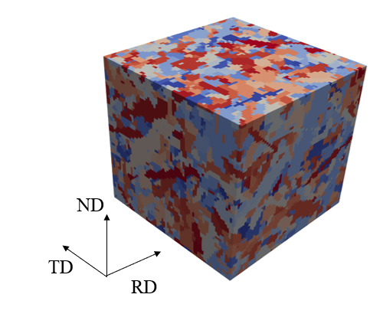
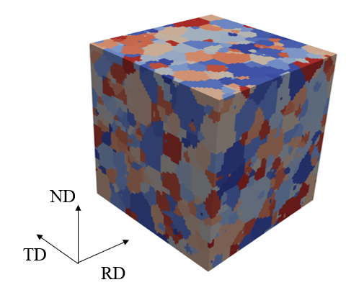
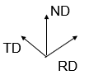
RVE with variant grain shape control
Input of grain shape aspect ratio of:
Very elongated Nearly equiaxed
1:0.1:0.1 1:0.9:0.9

Slide 12
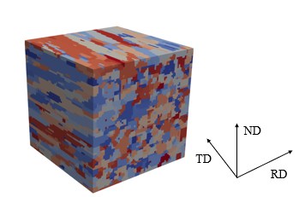
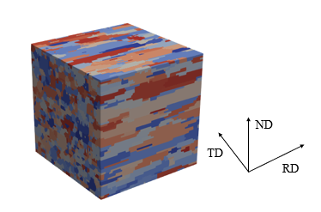
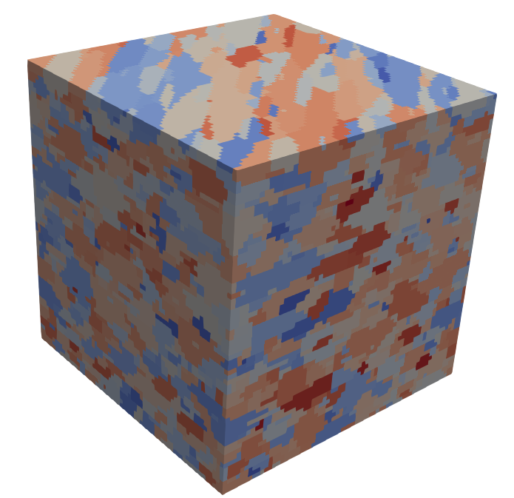
RVE with variant tilt angle control
45º
90º
180º

Slide 13
Conclusions and outlook
Conclusions
MRAC → Good method to evaluate RVE
Shape control method ( Grain shape distribution method)
Very good control of grain shape (Grain shape aspect ratio and axis orientation)
Optimal RVE with optimal mesh size
Modification of postprocess for grain shape from 3D to 2D
Control of size, shape and orientation distribution
Outlook
Control misorientation

Slide 14
Contact info.:
Email: Sheila.lizardischad@aalto.fi
Sheila.lizardi@alumni.mondragon.edu

